Slide 1
Moving towards end-to-end systems - Attention Mechanism & Pretrained Technic
Shared by：庞亮，熊睿彬，郝长盈

Slide 2
Roadmap
Language model
Attention
Elmo
Bert
QANet

Slide 3
Roadmap
Language model
Attention
Elmo
Bert
QANet

Slide 4
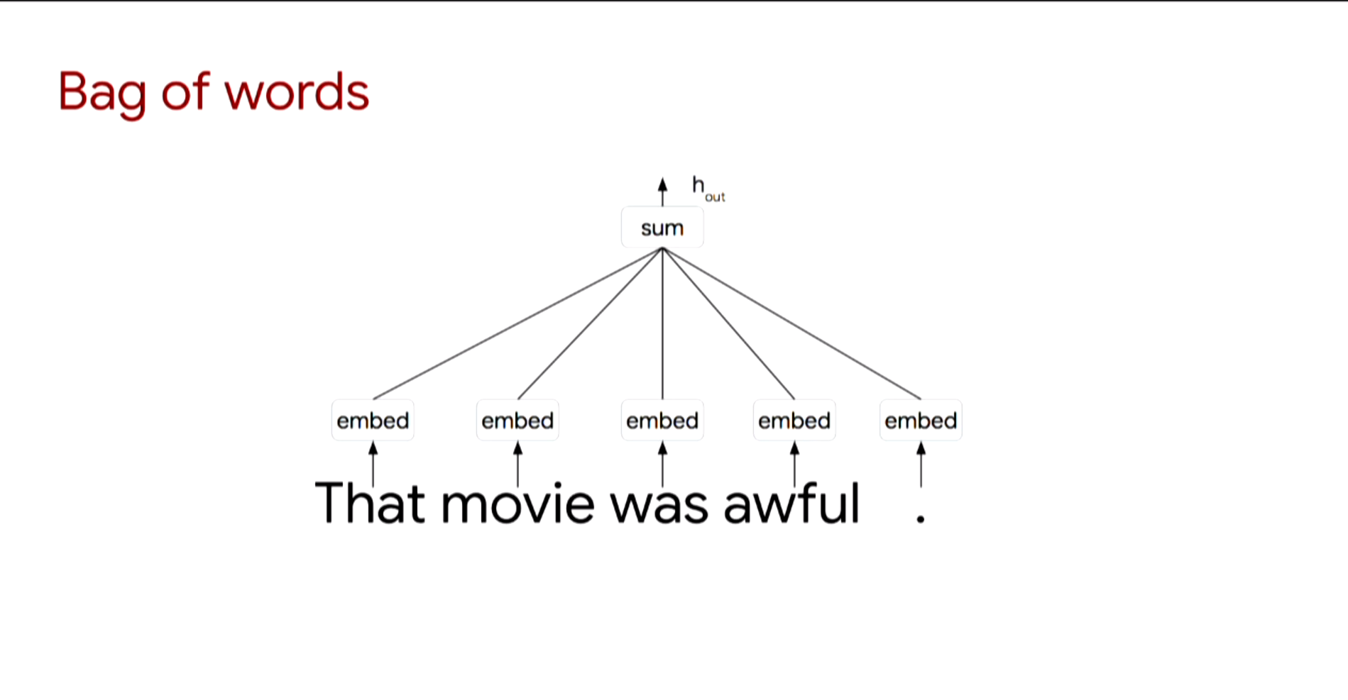

Slide 5
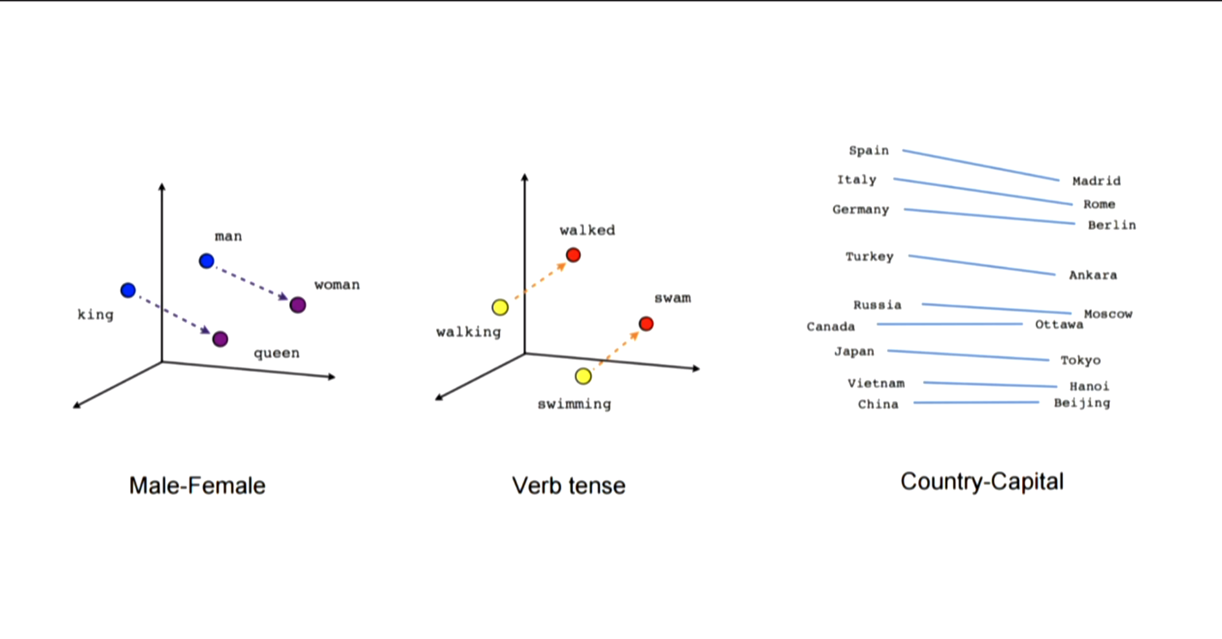

Slide 6
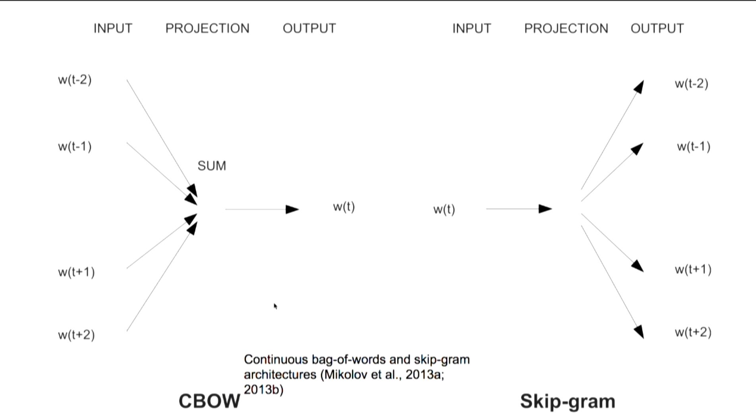

Slide 7
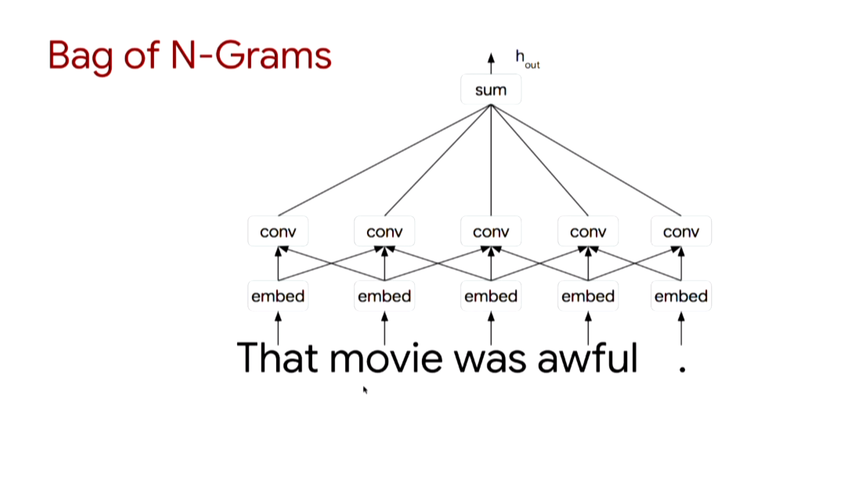

Slide 8
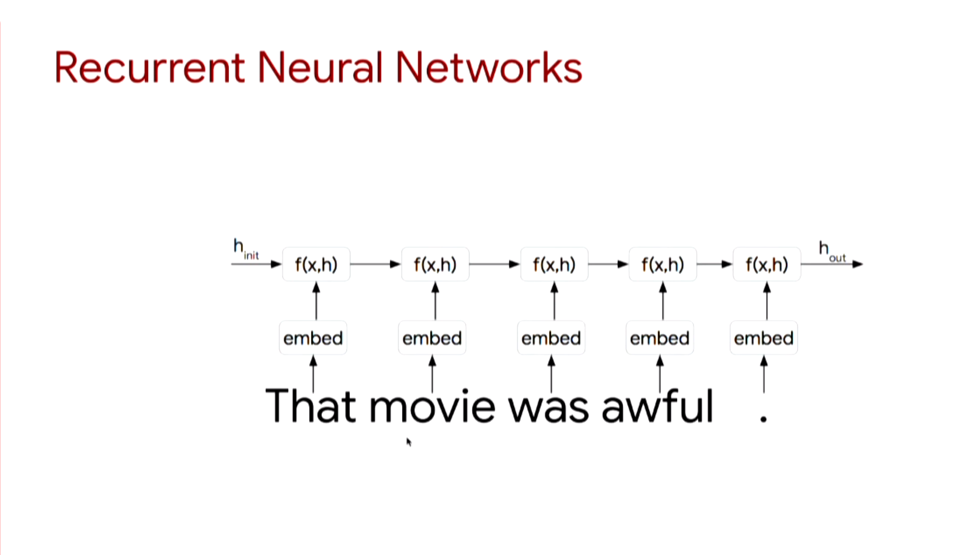

Slide 9
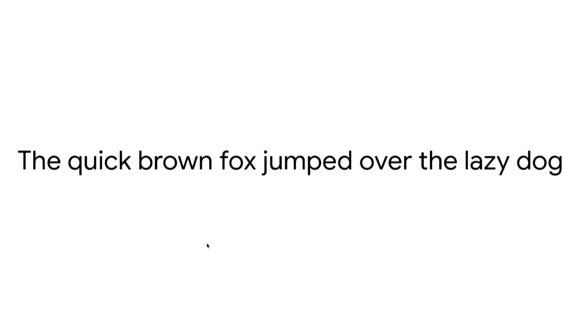

Slide 10
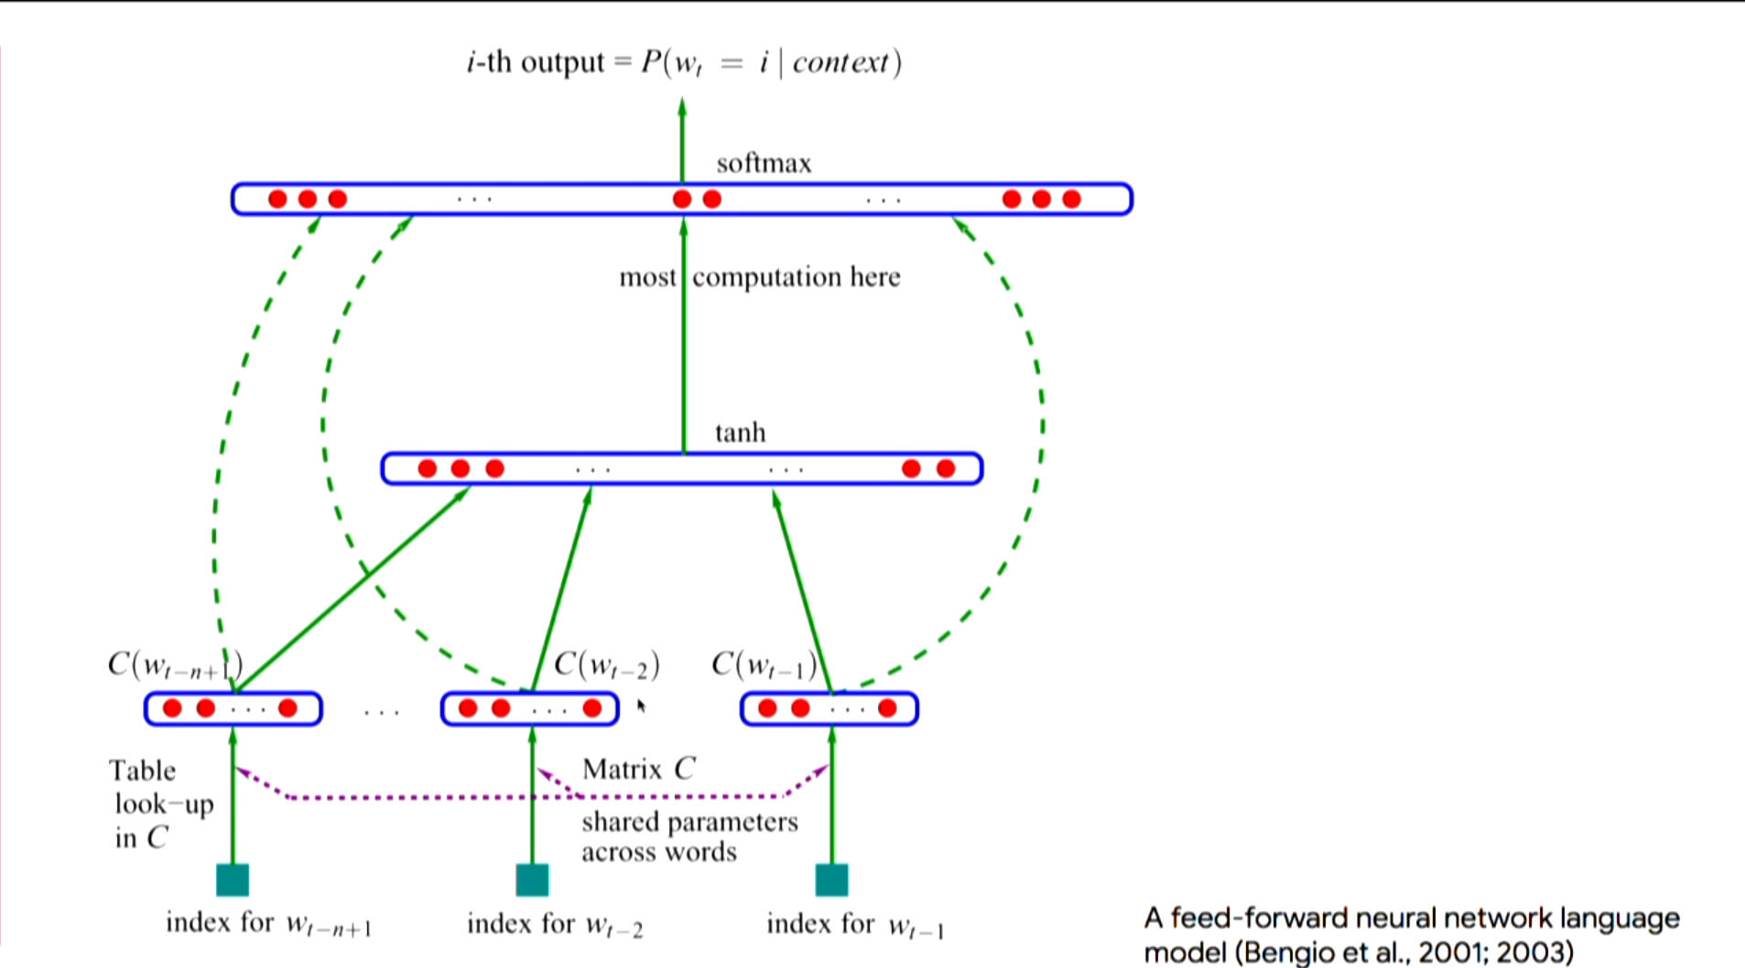

Slide 11
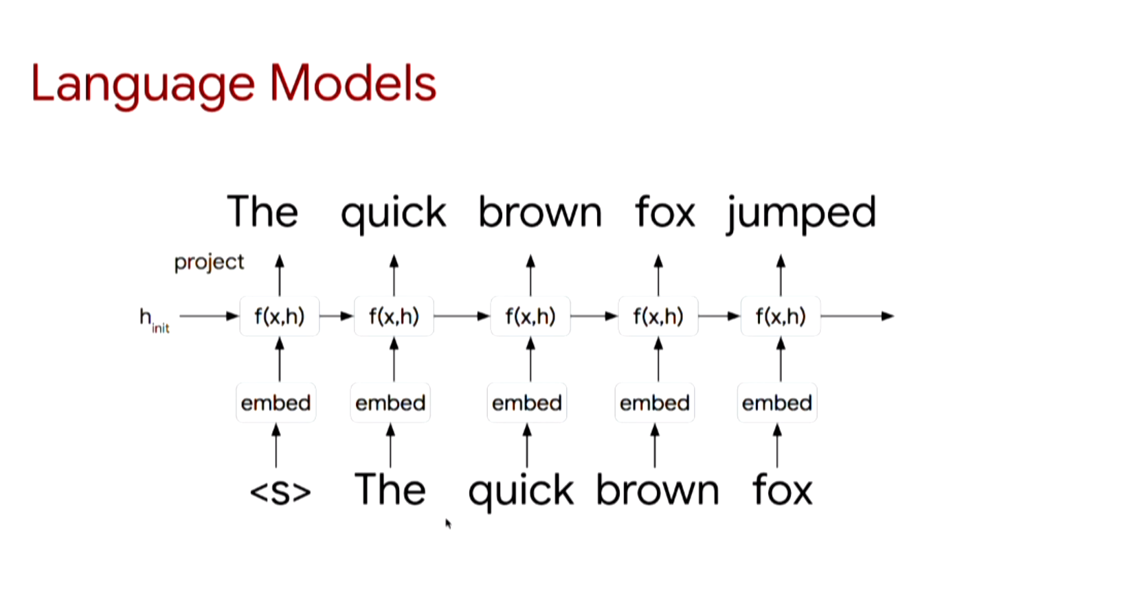

Slide 12
Roadmap
Language model
Attention
Elmo
Bert
QA net

Slide 13
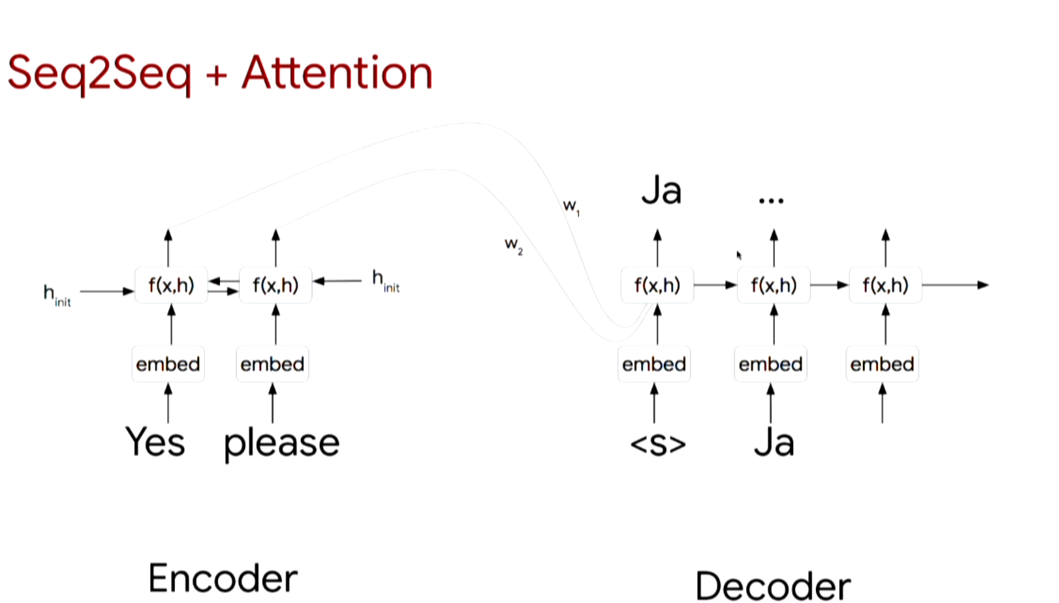

Slide 14
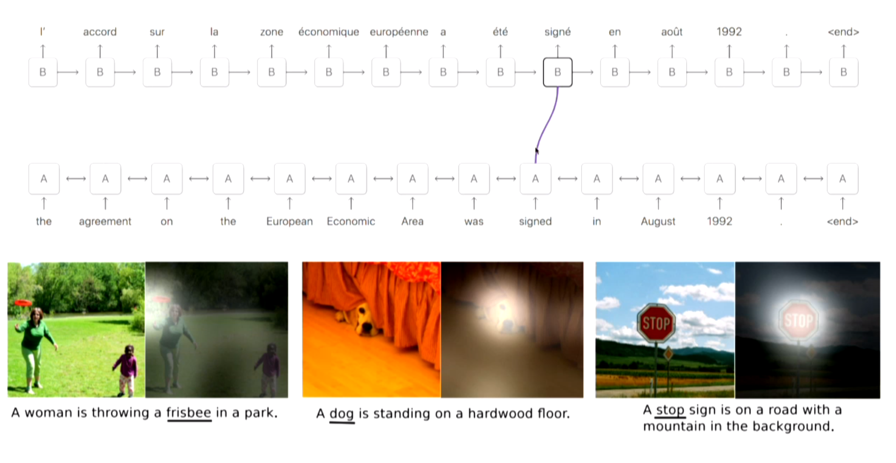

Slide 15
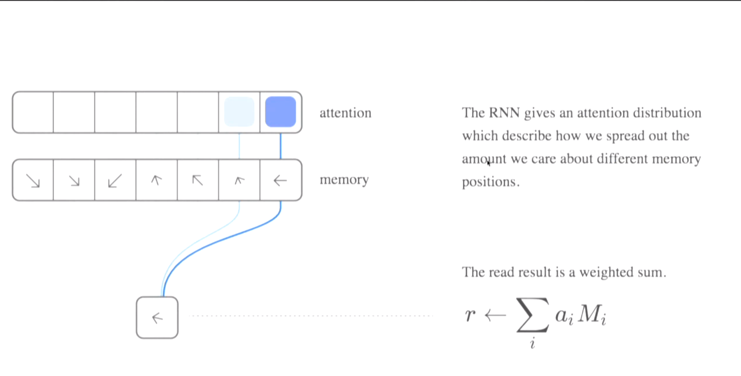

Slide 16
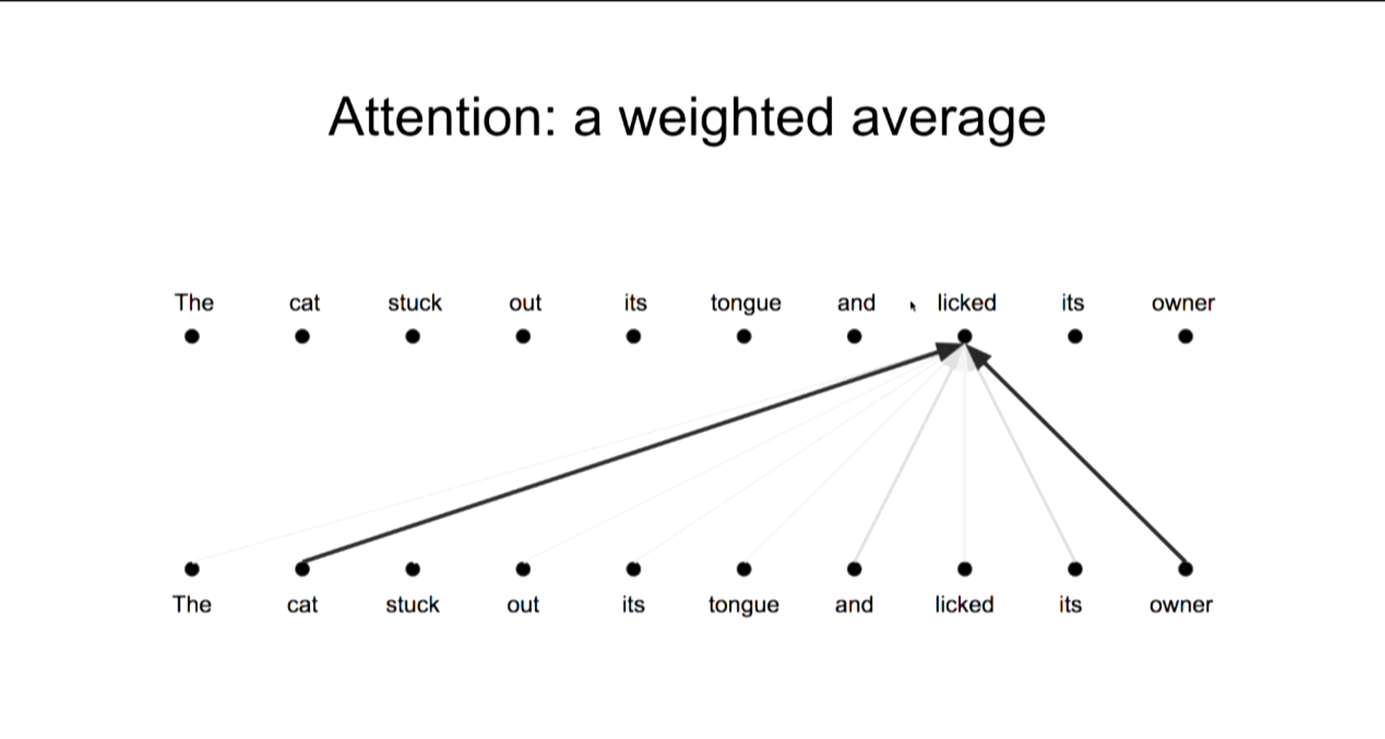

Slide 17
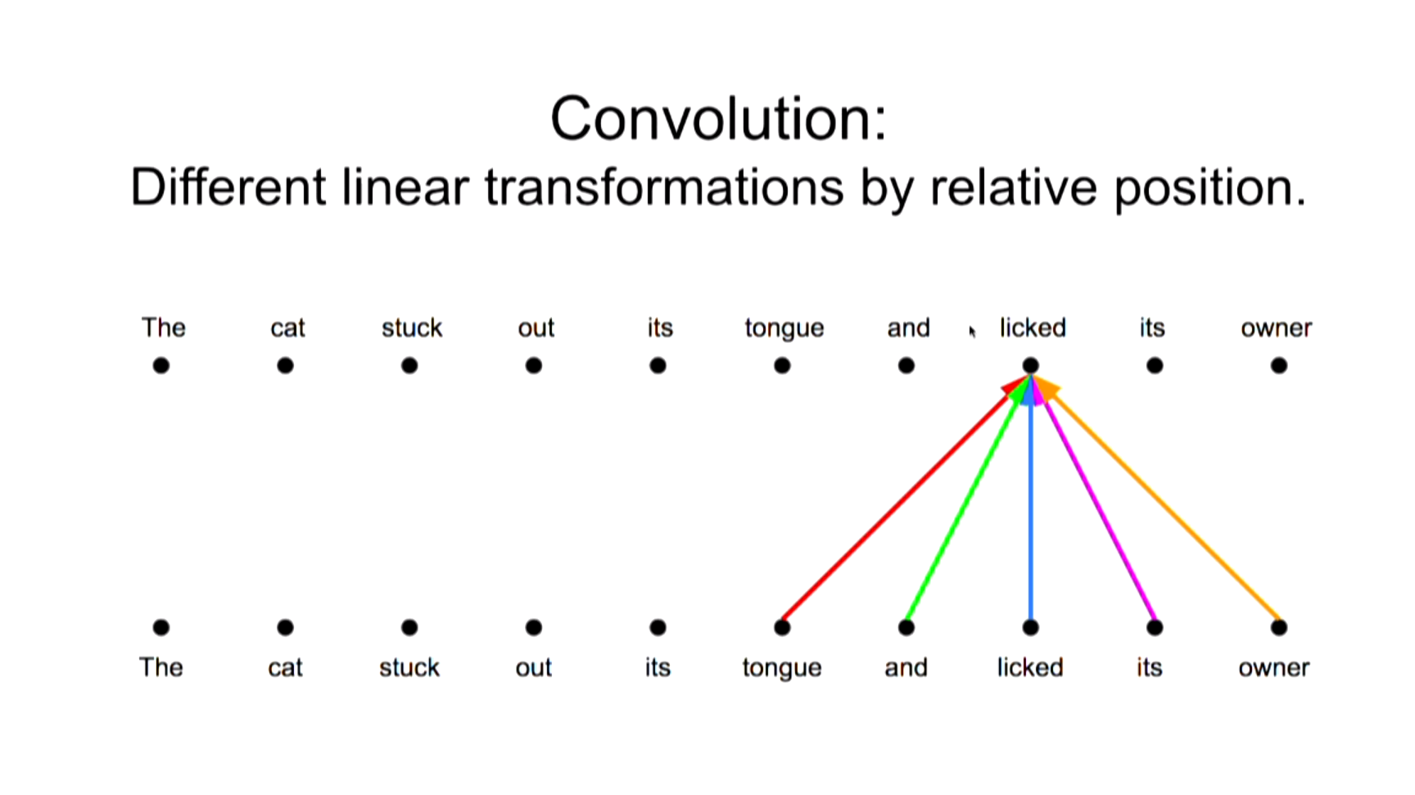

Slide 18
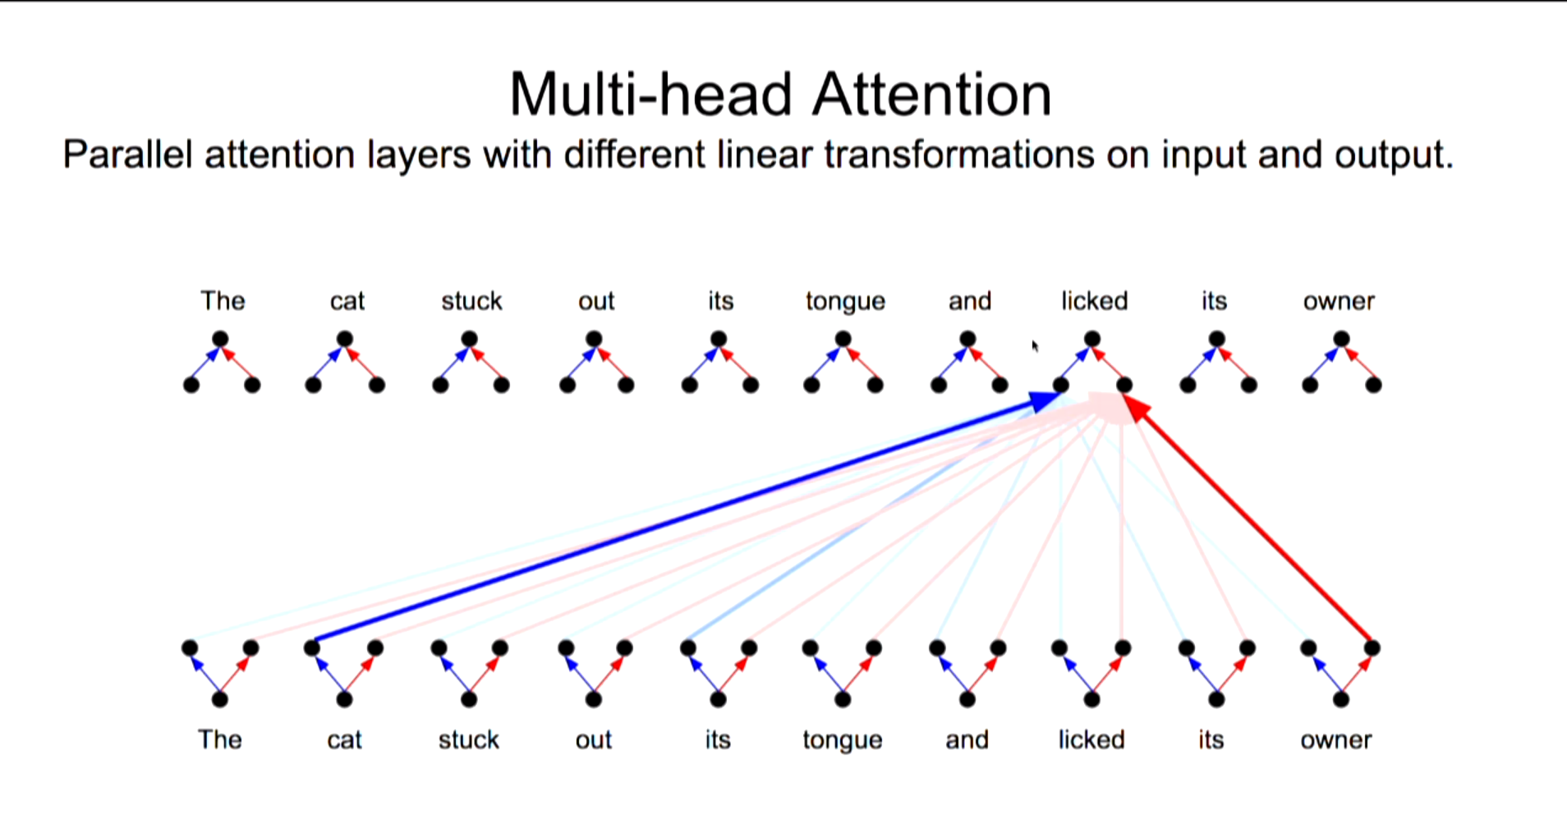

Slide 19
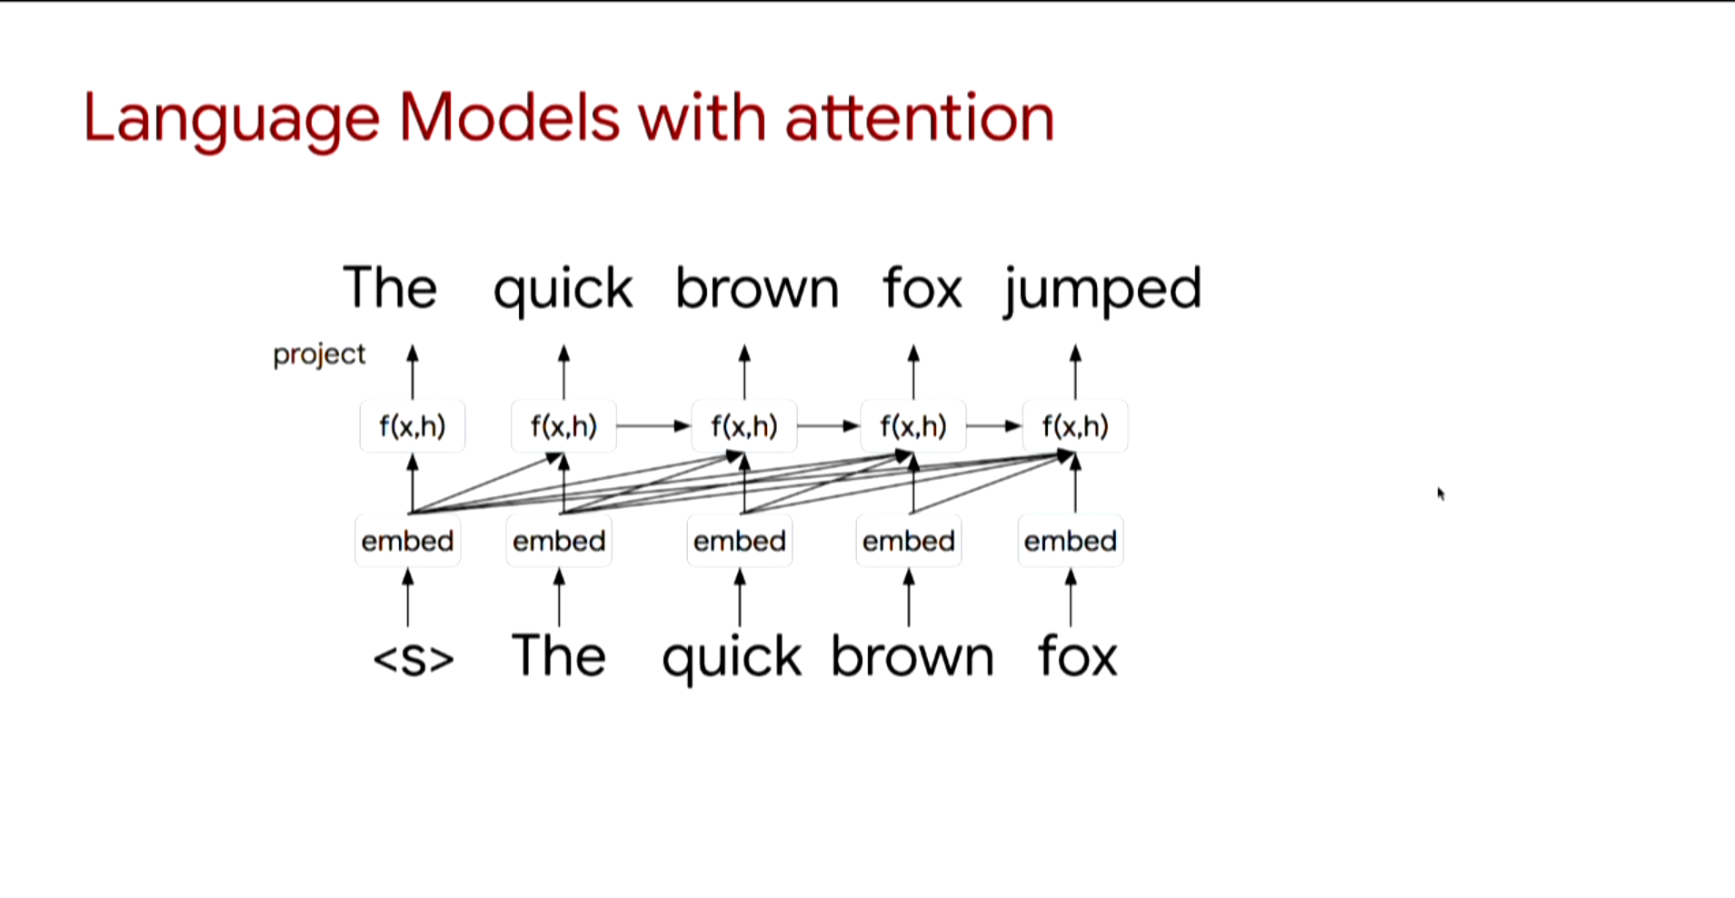

Slide 20
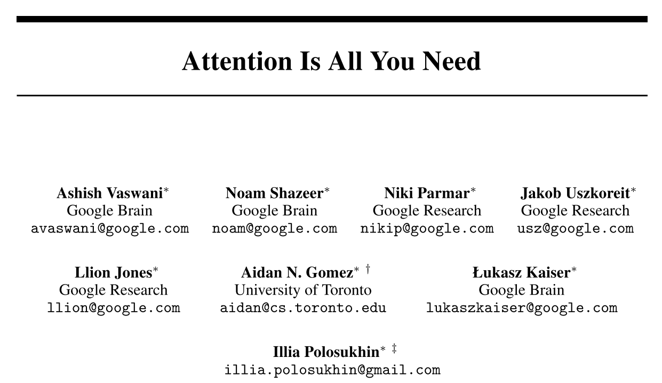
Attention Is All You Need

Slide 21
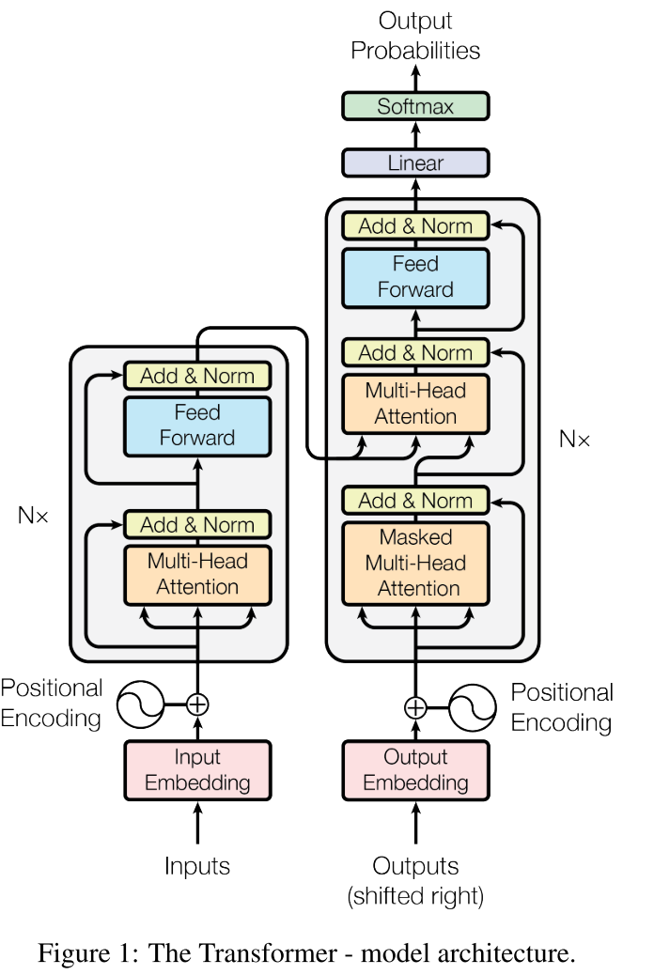
Attention Is All You Need

Slide 22
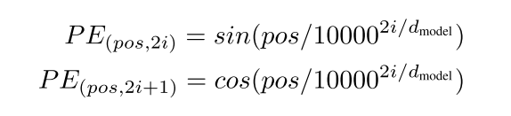
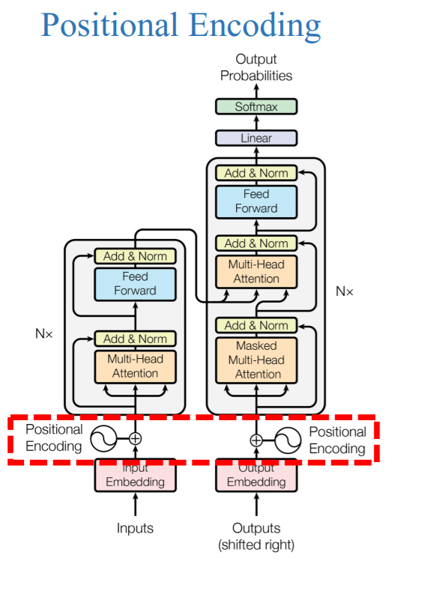
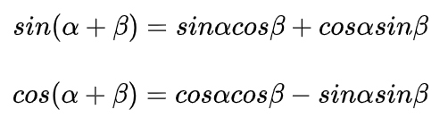
Attention Is All You Need
pos is the position, and i is the dimension
Chose this function because it would allow the model to easily learn to attend by relative positions
PE(pos+k) can be represented as a linear function of PE(pos) and PE(k)

Slide 23
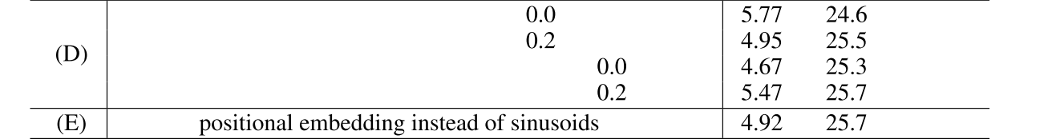
Attention Is All You Need
Why not using learned positional embeddings
two versions produced nearly identical results
Sinusoids may allow the model to extrapolate to sequence lengths longer than the ones encountered during training.

Slide 24
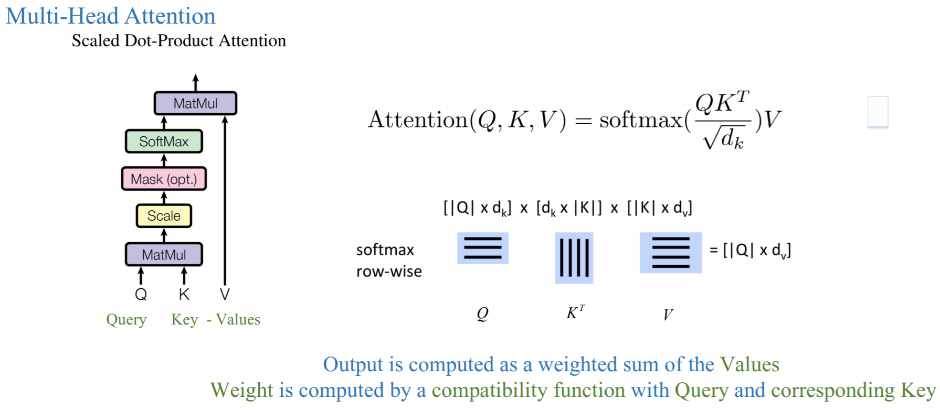
Attention Is All You Need

Slide 25
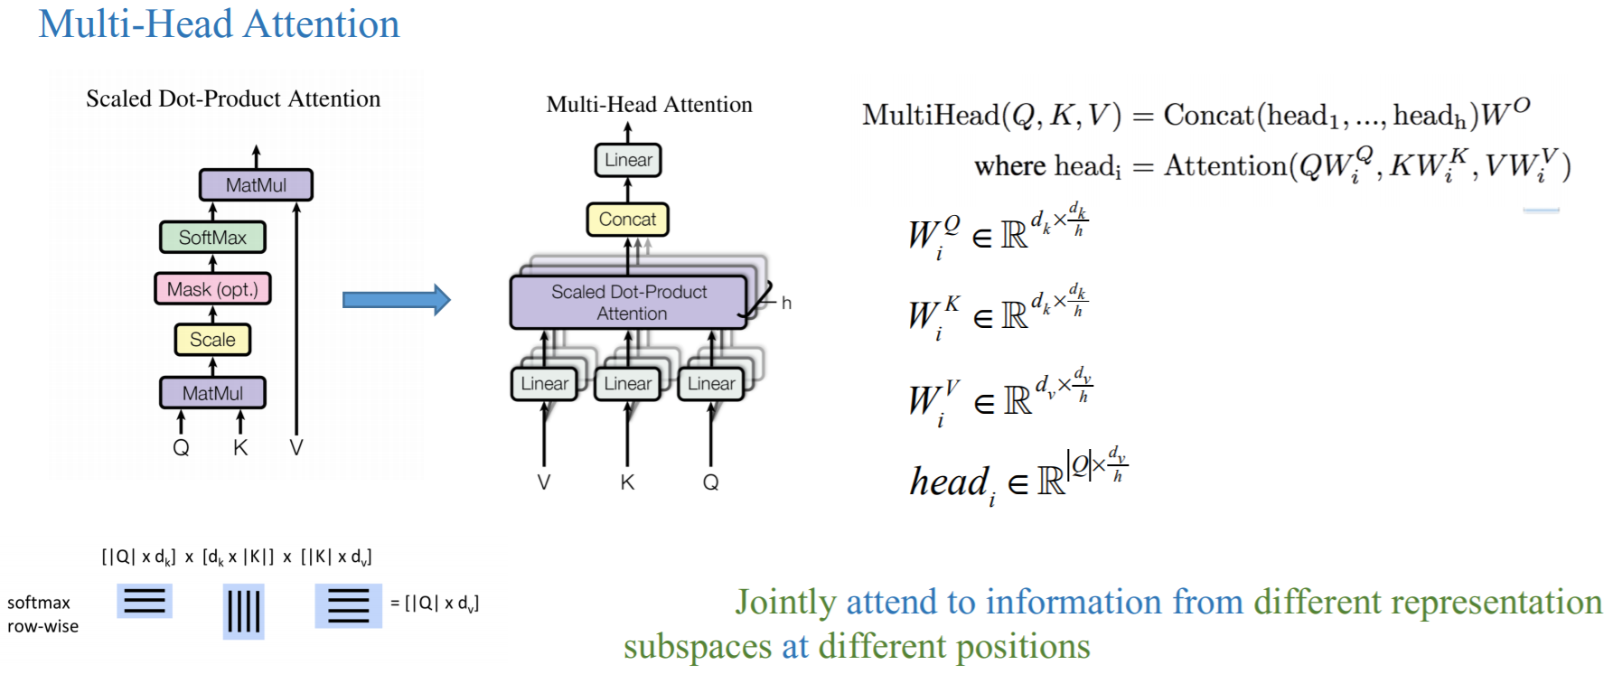
Attention Is All You Need

Slide 26
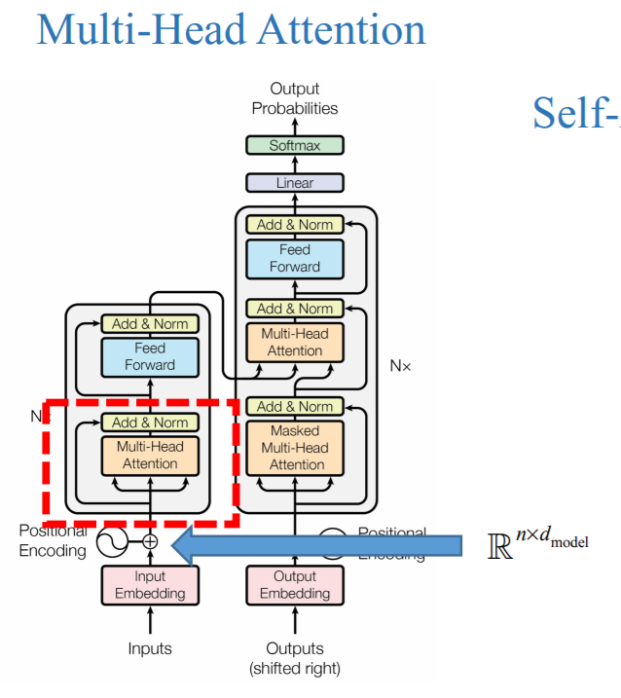
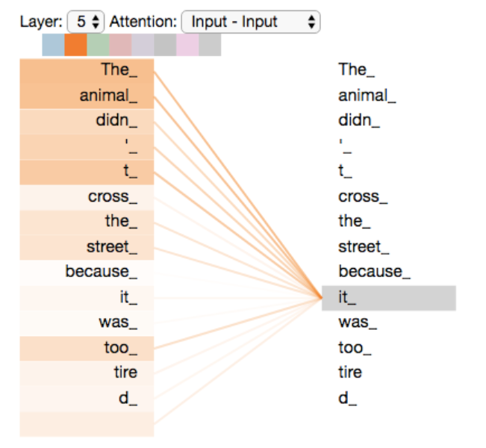
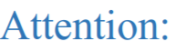
Attention Is All You Need

Slide 27
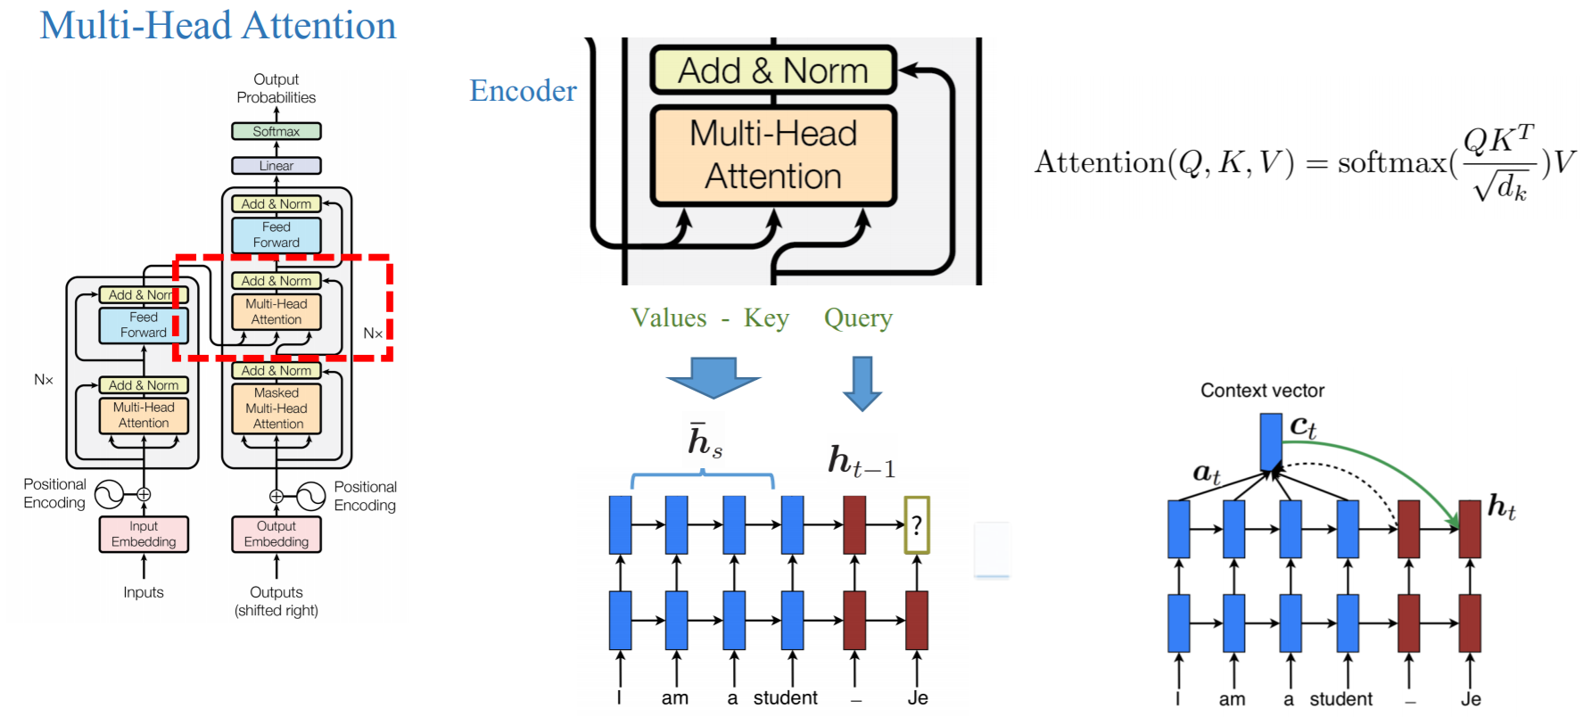
Attention Is All You Need

Slide 28
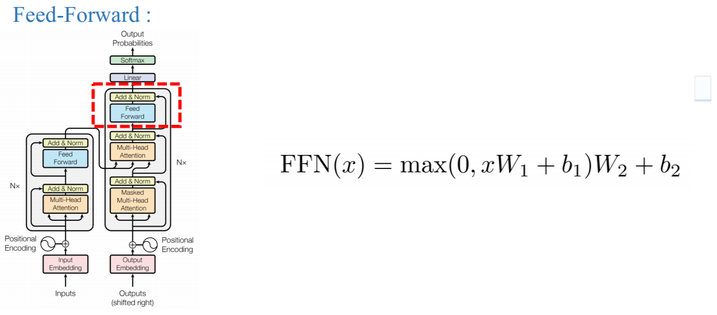
Attention Is All You Need

Slide 29
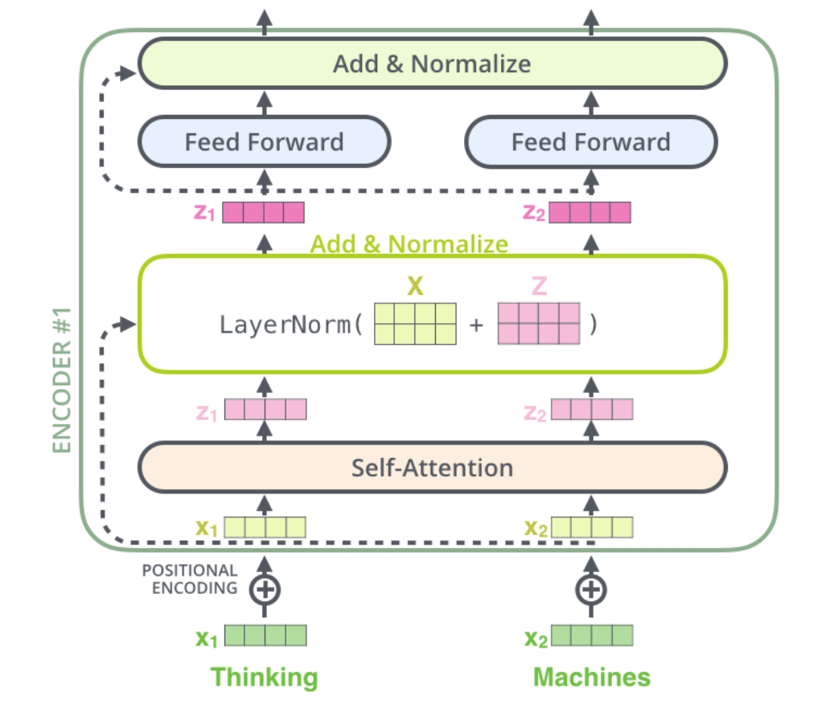
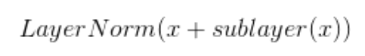
Attention Is All You Need
Add & Norm
Residual connection is employed around each of the two sub-layers, followed by layer normalization
By introducing residual connections, deeper model can be builded.
Layernorm is much faster than Batchnorm

Slide 30
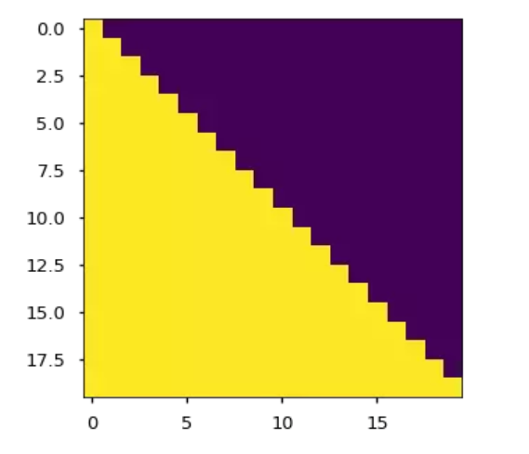
Attention Is All You Need
Masked Multi-Head Attention
In decoder, the auto-regressive property need to be preserved by preventing leftward information flow.
Solution: Mask

Slide 31
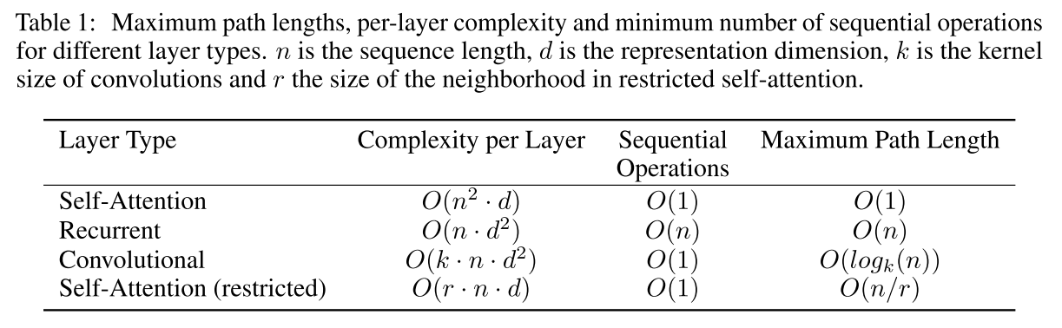
Attention Is All You Need
Why self-attention ?
Long dependency: self-attention layer connects all positions with a constant number of sequentially executed operations.

Slide 32
Attention Is All You Need
Why self-attention ?
Parallelization: Encoder is natural parallel, the decoder can be parallel in the training stage.

Slide 33
Attention Is All You Need
Why self-attention ?
Computational Complexity: When the sequence length n is smaller than the representation dimensionality d, self-attention is faster.
Restricted Self-Attention: considering only a neighborhood of size r. It reduce the computational complexity, but increase the maximum path length.

Slide 34
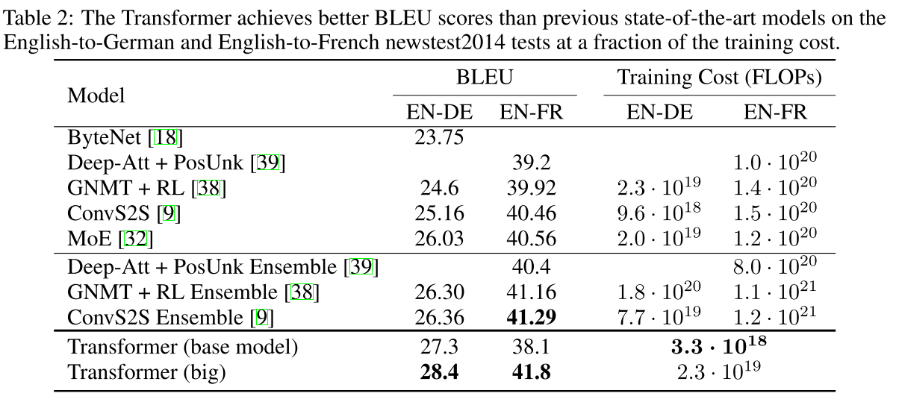
Attention Is All You Need
Experiment

Slide 35
Attention Is All You Need
Conclusion
Advantages
Learn long dependency easier than other model.
Efficient training.
Deeper model can be constructed cause the residual connection.
There is no problem of overlapping information that may exist within the RNN.
Disadvantages
Maybe not “attention is all you need”
…
Think about
What does attention mechanism learn ?
Why do we need self attention ?

Slide 36
Roadmap
Language model
Attention
Elmo
Bert
QANet

Slide 37
Deep contextualized word representations
ELMo (Embeddings from Language Models)
2018 NAACL outstanding paper award
Propose a new deep contextualized word representation
models both
(1) complex characteristics of word use (e.g., syntax and semantics), and
(2) how these uses vary across linguistic contexts (i.e., to model polysemy)
word vectors are learned functions of the internal states of a deep bidirectional language model, which is pretrained on a large text corpus
can improve existing neural models in various NLP tasks
can capture more abstract linguistic characteristics in the higher lever of layers

Slide 38
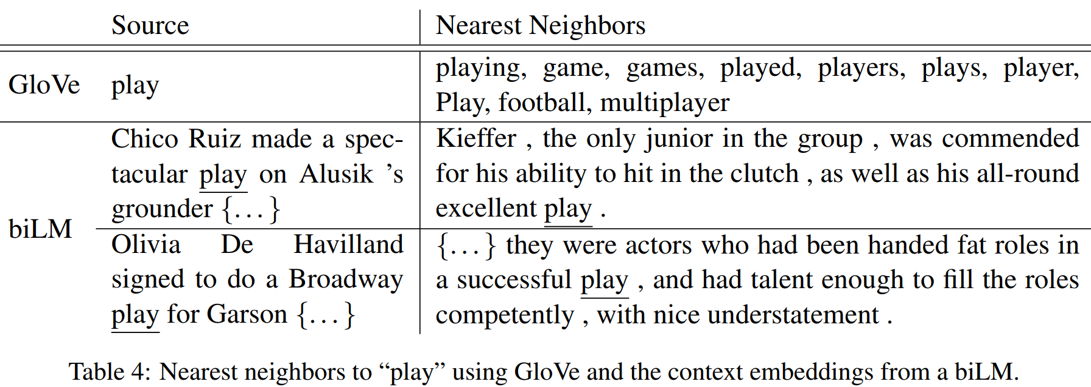
Example
Glove mostly learns
Sport-related context
Elmo can distinguish the word
Sense based on the context

Slide 39
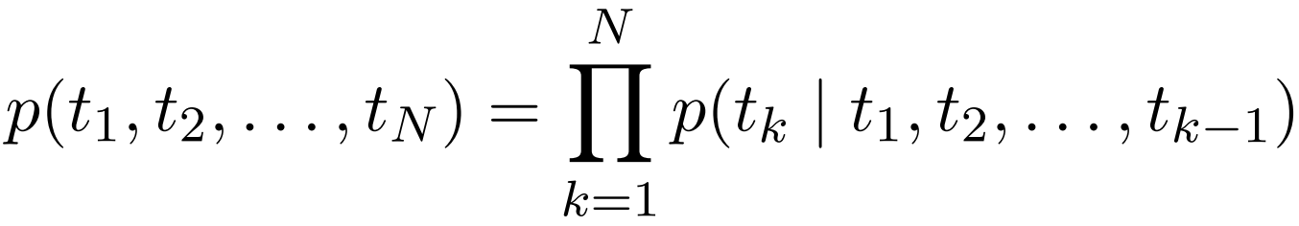
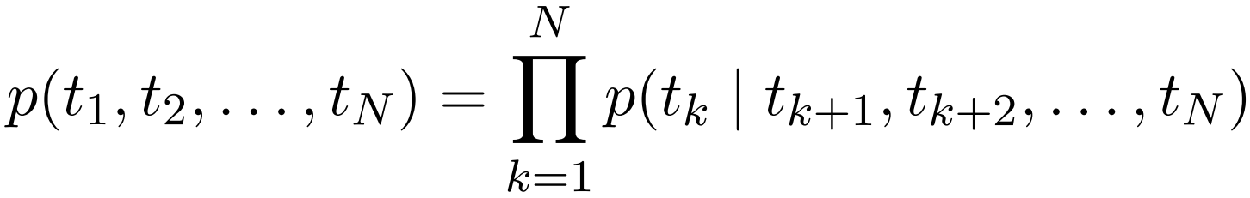
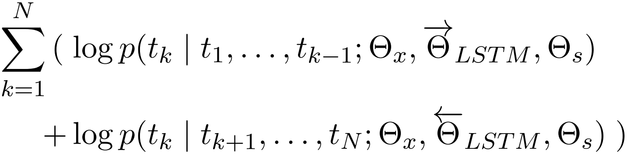
Bidirectional language models

Slide 40
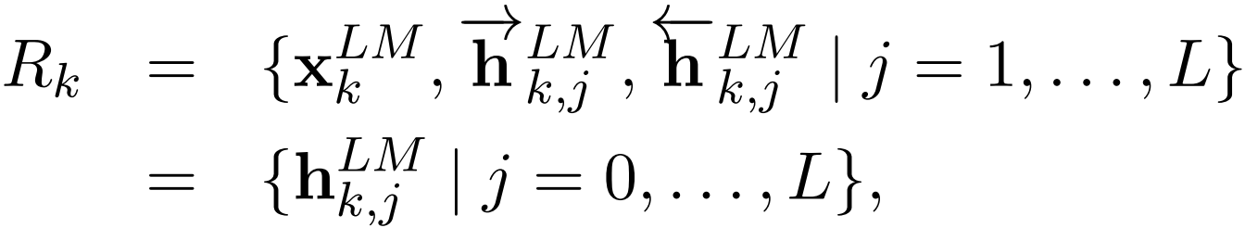
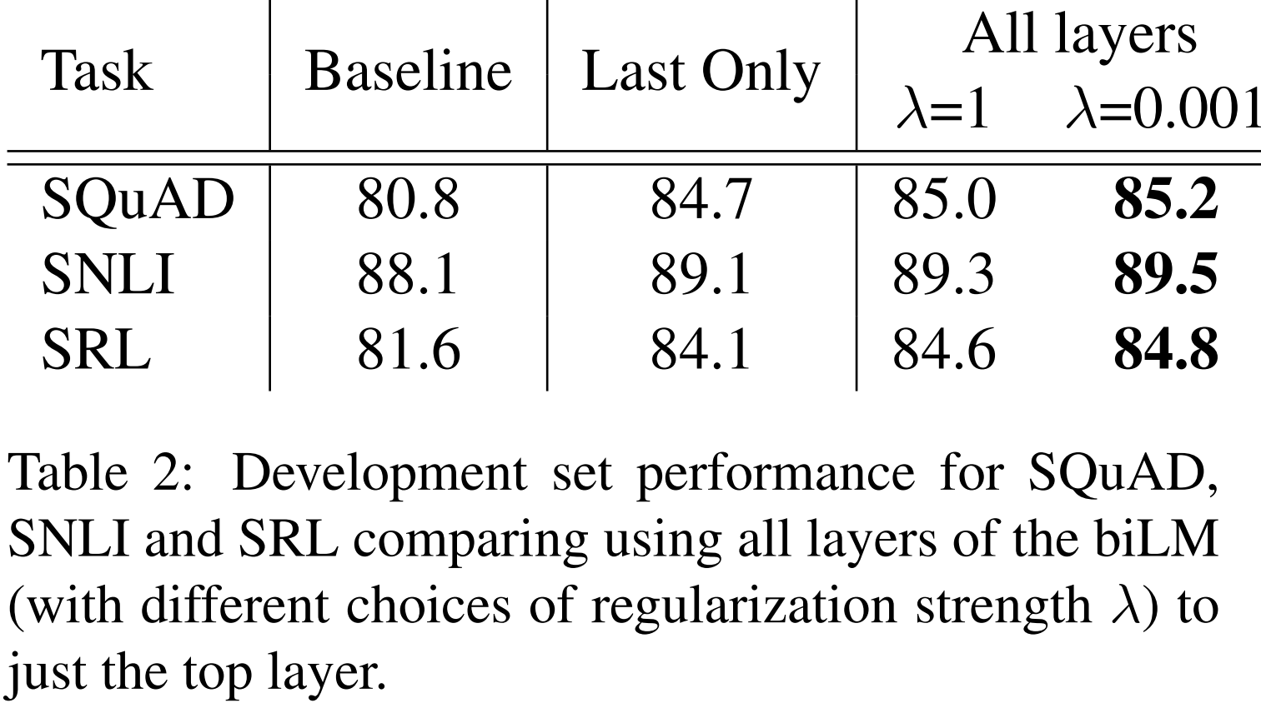
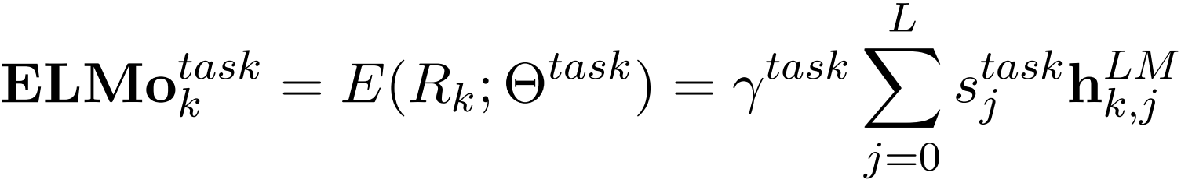
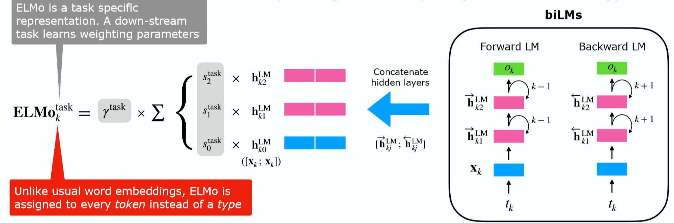
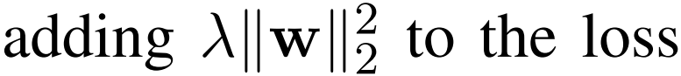
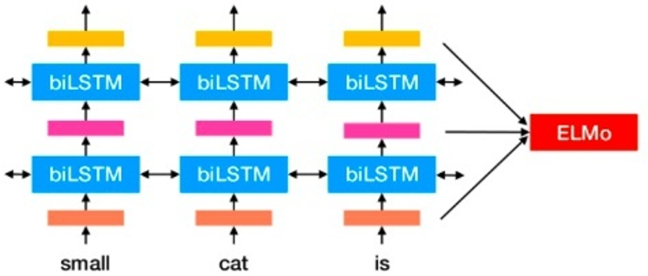
ELMo

Slide 41
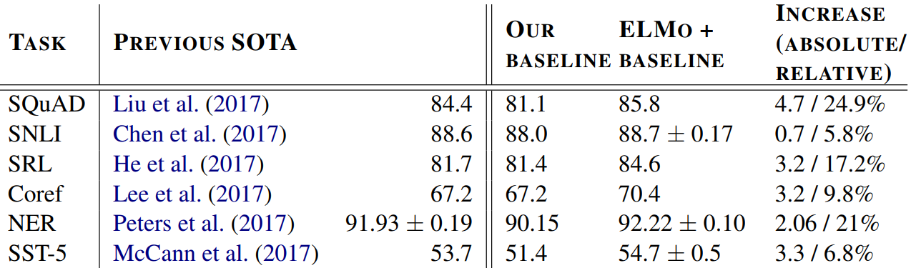
Evaluation on supervised NLP tasks
Question answering, Textual entailment, Semantic role labeling
Coreference resolution, Named entity extraction, Sentiment analysis
In every task considered, simply adding ELMo establishes a new
state-of-the-art result.

Slide 42
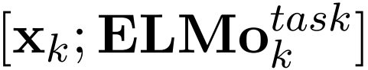
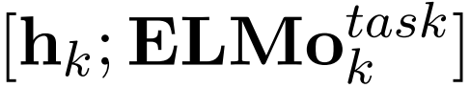
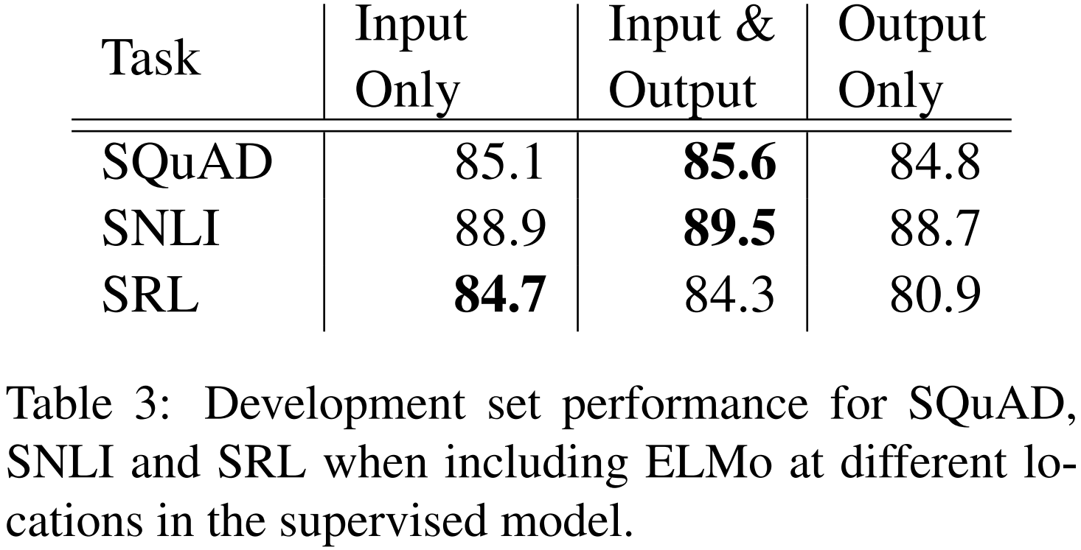
Where to include Elmo

Slide 43
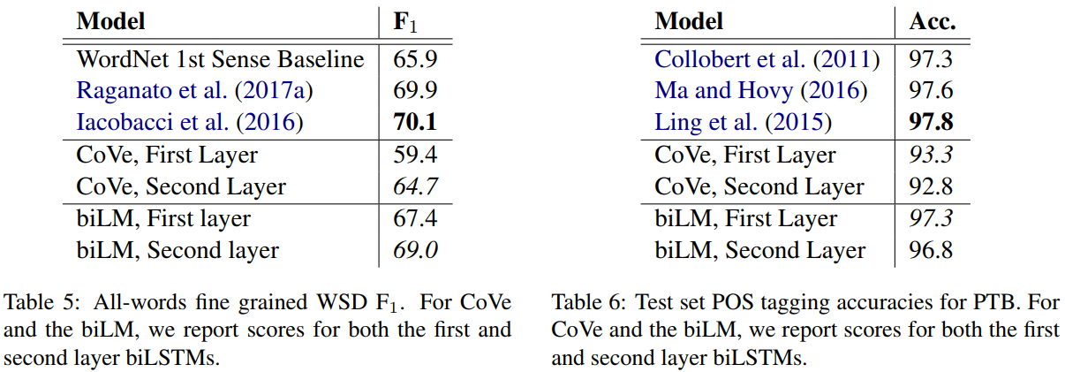
What information does biLM’s representations capture
Higher layer biLM: Semantic
Lower layer biLM: Syntax

Slide 44
Conclusion
Language Modeling is effective in constructing contextualized representation (could be helpful for a variety of tasks);
Outputs of all Layers are useful.

Slide 45
Roadmap
Language model
Attention
Elmo
Bert
QANet

Slide 46
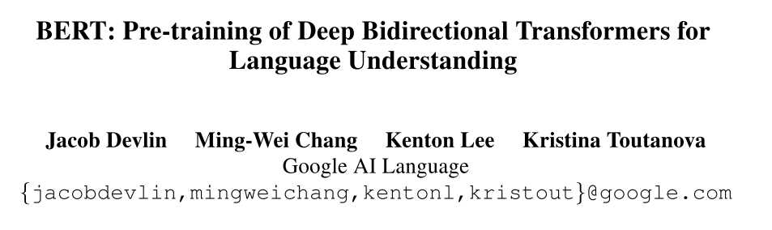
BERT

Slide 47
BERT
Language model pre-training has shown to be effective for improving many natural language processing tasks
There are two existing strategies for applying pre-trained language representations to downstream tasks:
Feature-based Approaches：uses tasks-specific architectures that include the pre-trained representations as additional features.
Fine-tuning Approaches：trained on the downstream tasks by simply fine-tuning the pretrained parameters

Slide 48
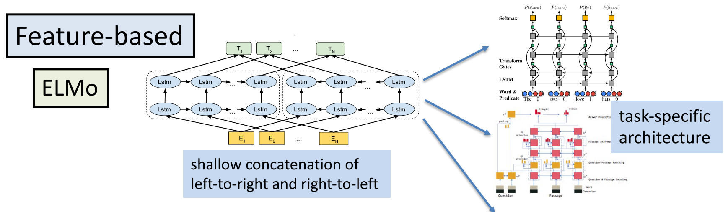
BERT

Slide 49

BERT

Slide 50

BERT-Model Architecture

Slide 51

BERT-Input Representation
Sentence pairs are packed together into a single sequence, The sentences are differentiated by [SEP] and segment embeddings.
Position Embeddings：Learnable parameters, initialize randomly (different from transformer). The embedding supported sequence lengths up to 512 tokens.
The final hidden state corresponding to [CLS] is used as the aggregate sequence representation for classification tasks.
30,000 token vocabulary.

Slide 52

BERT-Pretrained Task

Slide 53

BERT-Pretrained Task 1
Solution: Masked LM (Cloze Task)
Mask 15% tokens, and predict them given deep bidirectional representations
But, the strategy introducing mismatch between pre-training and finetuning.
Solution:
80% of the time: Replace the word with the [MASK] token
10% of the time: Replace the word with a random word
10% of the time: Keep the word unchanged,

Slide 54

BERT-Pretrained Task 2
Understanding the relation between sentences is important in QA and Inference

Slide 55

BERT-Fine Tuning

Slide 56

BERT-GLUE Result

Slide 57

BERT-SQUAD Result

Slide 58

BERT-Name Entity Recognition Result

Slide 59

BERT-Ablation Studies
No NSP: A model which is trained using the “masked LM” (MLM) but without the “next sentence prediction” (NSP)
LTR & No NSP: A model which is trained using a Left-to-Right (LTR) LM, rather than an MLM
+BiLSTM: adding a randomly initialized BiLSTM on top of “LTR & No NSP” for finetuning
The larger the model, the better the performance.

Slide 60

BERT-Feature-Based Approach with BERT
The advantages of the feature-based approach
not all NLP tasks can be easily be represented by a Transformer encoder architecture
computational benefits

Slide 61
Conclusion
Very deep pretrained bidirectional language model can benefit the downstream task model.
Think about
What core information of the language dose BERT capture?
How does this information work on other tasks?

Slide 62
Roadmap
Language model
Attention
Elmo
Bert
QANet

Slide 63



Slide 64






Slide 65
Challenges of RNN

Slide 66


Slide 67


Slide 68


Slide 69
Idea #1:
Combining convolution & self-attention

Slide 70


Slide 71


Slide 72


Slide 73


Slide 74


Slide 75

QANet – No Recurrence

Slide 76

QANet – Separable Convolution

Slide 77

QANet – Lots of Regularizations

Slide 78



Slide 79
Idea #2:
Data Augmentation for Text

Slide 80

Data augmentation: popular in vision, but not NLP

Slide 81



Slide 82

QANet augmentation
Any other methods except for back-translation
for data augmentation?

Slide 83
Idea #3:
Deep Embedding through Transfer Learning

Slide 84



Slide 85


Slide 86


Slide 87
Thanks !

